Slide 1
Hospital Management System

Slide 2
Hospital Management System in java. This system has a home page from where the administrator can login. On logging in the user can add details of patients and doctors.

Slide 3
OBJECTIVE OF THIS PROJECT
This project system was highly recommended due to the rapid increase of computer related tools in the industry.
With this proposed system features and functions of Hospital Management System that will be able to accommodate more reliably consistently and faster in providing a better service to the users.

Slide 4

SOFTWARE AND HARDWARE REQUIREMENTS
HARDWARE REQUIREMENTS:
Processor : intel i5
Motherboard : intel 915gvsr chipset board
Ram : 4 gb ddr2 ram
Hard disk drive : 160 gb
SOFTWARE REQUIREMENTS:
Front end : Java Swing
Back end : mysql, java

Slide 5
Patient Module: This module gives us the information about both in-patient and out-patient. patients id, name ,address ,admitted date, doctor and rooms allotted are entered in this form for further references ,so as to refer a particular patients details using a separate form with an attribute ,patient id. It also includes payment details of a patient depending on the reports generated

Slide 6
Doctor details Module: This module gives us the details of all the doctors associated with the hospitals including the regular and specialized doctors like Doctor’sName, specialization, qualification and the patient he is allotted to.

Slide 7
TARGET AUDIENCE: This project will enhance the start up hospitals to serve people more quickly and efficiently. This software is developed in order to computerize the activities which take more time, if done manually.

Slide 8
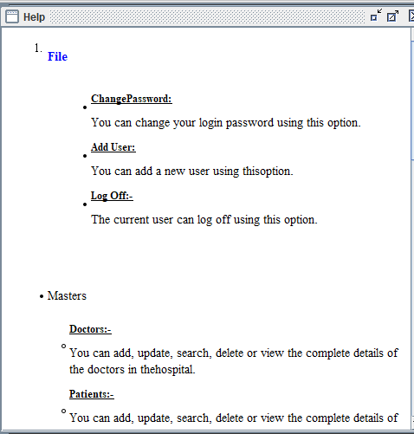
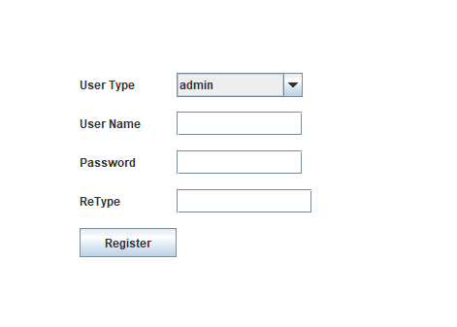
SCREENSHOTS

Slide 9
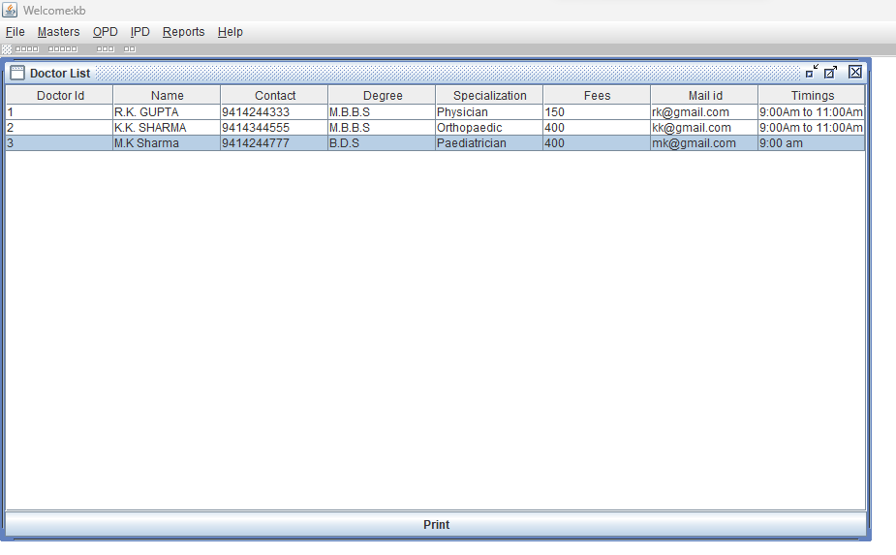

Slide 10
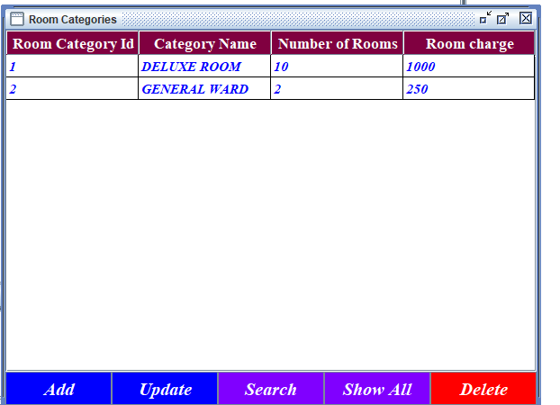
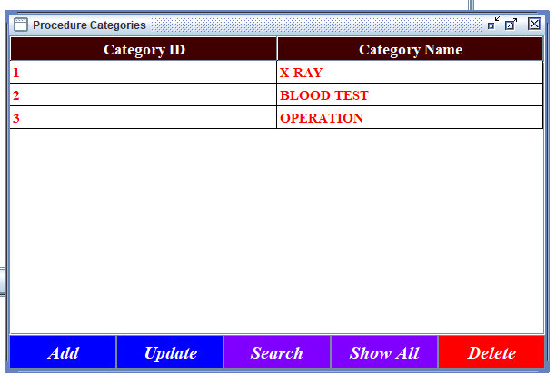

Slide 11
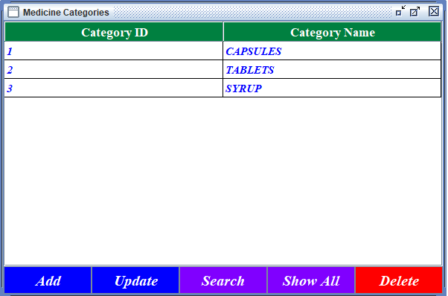
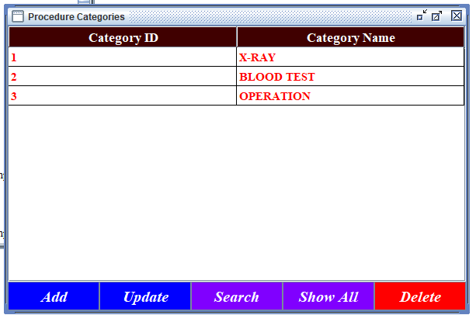

Slide 12
CONCLUSION
Hence we have designed the project to provide the user with easy navigation, retrieval of data, and necessary feedback as much as possible.
In this project, the user is provided with an online system that can be used to retrieve the data of doctors, patients.
This project helps in understanding the creation of interaction and the transparency between the Doctor, patient, and Management of the hospital.

Slide 13
FUTURE ENHANCEMENT
In Future work, This application to develop a cross platforms like IOS, etc.
In adding the more features of OPD and IPD to develop access with user’s flexibility.
To authenticate the users based on the system users list which is maintained by the operating system
To restrict the usage of all files by the users based on their privileges on the system

